Slide 1
8B1/Sc
My Targets;
8 – Use mini-plenaries to assess progress and re-shape activities
6 – Plan activities to improve student motivation and resilience to allow for more independent learners
Lesson Planning Ticksheet
Task adjustment
High attainers
Pride
Exam / SATS / application question
Exemplar answers for assessment use
Lit
N

Slide 2
8B1/Sc IEP Actions & Class Profile
Treavon Gayle
Nut allergy (epipen)
Explain to me what task is
Copy of boardwork / powerpoint
Assign role in group work
Ask how to spell new words
Sentence starters, keywords and writing frames for extended writing
Visual aids for new concepts
George Camies
Whiteboard for extended writing

Slide 3
8B1/Sc Seating Plan
A
6c 5a
PP
Ryan Reynolds
5a 6c
Shuayb Rahman
7c 6a
Joseph Hollington
HA
6c 6a
Yanika Montiero
HA
7a 5a
Jamie McCarthy
6a 6c
PP HA
Gabriel Oduneye
P+
S
7c 5c
Nikolas Begolli
5a 6c
EAL
Sandesh Rimal
PP
8c 6c
HA
Ejshadia Kasako
6a 5a
HA
Khian Bergin
6c 5c
HA
Alex Deakin
EAL
HA
6b 5a
PP HA
Billy Murphy
5a 6c
EAL
Vakare Vysniauskaite
HA
6a 6b
Maggie Idio
HA
6b 4b
Tyrek Kalala
6a 5b
Ethan Watts
HA
6b 5a
Tilly Jones
5a 5b
PP
Charlie Mathieson
4a 6b
EAL
Victor Ikea
7b 7c
PP A HA
James Penson
6c 5c
Chelsea Callaghan
5a 5b
A
Jamie Page
7b 6b
PP A
Steven Sheppard
5a 5b
PP
Billy Flower
6c 5b
Luke Smith
6b 5b
PP Rhianne Porter
6a 5a
Jai Corbett
6a 5a
Ellie Fox
6b 5b
PP
Olabisi Bamidele
1
2
3
4
5
6
Teacher’s Desk

Slide 4
8B1/Sc Homework
Set:
To hand in:

Slide 5
Microbes Literacy Assessment Prep
Keywords: pathogen, bacteria, fungi, virus, stomach acid, cilia, skin, tears, enzymes, mucus, phagocytes lymphocytes, antibodies
Level 4 | List three types of microbe (microorganism), and say where you might find them. | 3 marks
Level 5 | Describe 3 ways that the body prevents microbes getting into your body. | 5 marks
Level 6 | Explain how white blood cells fight infection. | 7 marks
Level 7 | Suggest what the effect would be if someone had a low white blood cell count. | 9 marks
Do Now
What are the three types of microbes?
FUNGI
BACTERIA
VIRUS

Slide 6
Microbes Literacy Assessment Prep
Keywords: pathogen, bacteria, fungi, virus, stomach acid, cilia, skin, tears, enzymes, mucus, phagocytes lymphocytes, antibodies
Level 4 | List three types of microbe (microorganism), and say where you might find them. | 3 marks
Level 5 | Describe 3 ways that the body prevents microbes getting into your body. | 5 marks
Level 6 | Explain how white blood cells fight infection. | 7 marks
Level 7 | Suggest what the effect would be if someone had a low white blood cell count. | 9 marks
What are the different ways your body prevents microbes getting in?
Use the keywords to fill in the blanks on the sheet.
WHAT is the defence
HOW does it work?

Slide 7
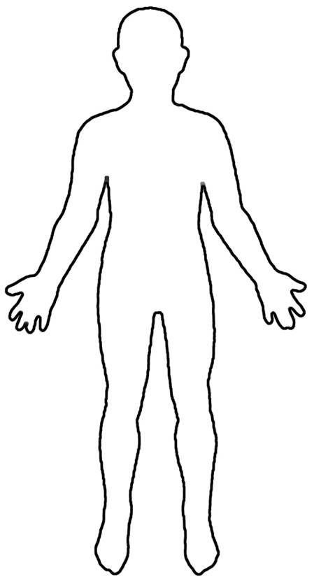
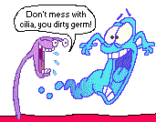
Self-Defence Against Microbes!!

Slide 8
Self-Defence Against Microbes!!
Enzyme in tears kills bacteria
Hairs and mucous in nose trap dust and microbes
Acid in the stomach kills bacteria
Cilia and mucous in trachea trap bacteria
Skin is a barrier to microbes entering blood

Slide 9
Microbes Literacy Assessment Prep
Keywords: pathogen, bacteria, fungi, virus, stomach acid, cilia, skin, tears, enzymes, mucus, phagocytes lymphocytes, antibodies
Level 4 | List three types of microbe (microorganism), and say where you might find them. | 3 marks
Level 5 | Describe 3 ways that the body prevents microbes getting into your body. | 5 marks
Level 6 | Explain how white blood cells fight infection. | 7 marks
Level 7 | Suggest what the effect would be if someone had a low white blood cell count. | 9 marks
Watch this video on white blood cells.
What are the two types of white blood cell?
How do they work?
Phagocytes…..
Lymphocytes….

Slide 10
Microbes Literacy Assessment Prep
Keywords: pathogen, bacteria, fungi, virus, stomach acid, cilia, skin, tears, enzymes, mucus, phagocytes lymphocytes, antibodies
Level 4 | List three types of microbe (microorganism), and say where you might find them. | 3 marks
Level 5 | Describe 3 ways that the body prevents microbes getting into your body. | 5 marks
Level 6 | Explain how white blood cells fight infection. | 7 marks
Level 7 | Suggest what the effect would be if someone had a low white blood cell count. | 9 marks
If you had a low white blood cell count, how would it affect your health?
Think, pair, share.
Your immune system would be low, and you would be less able to fight off infection from pathogens. You might get ill more often.

